Slide 1
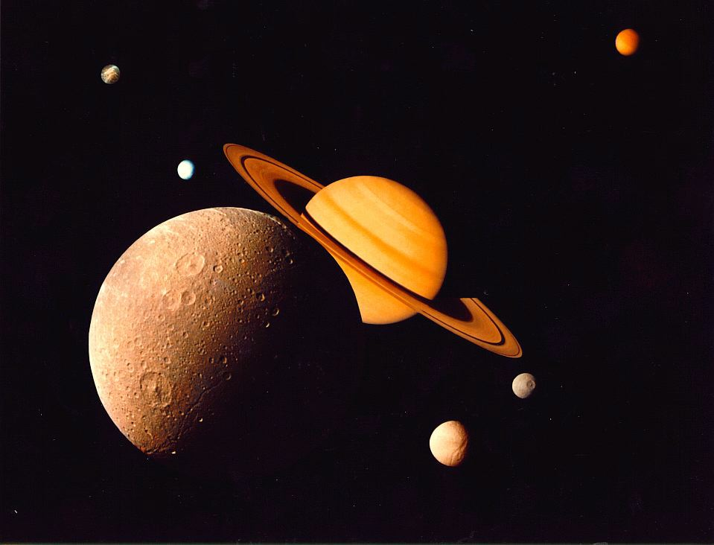
Moons, Rings & Other Things

Slide 2
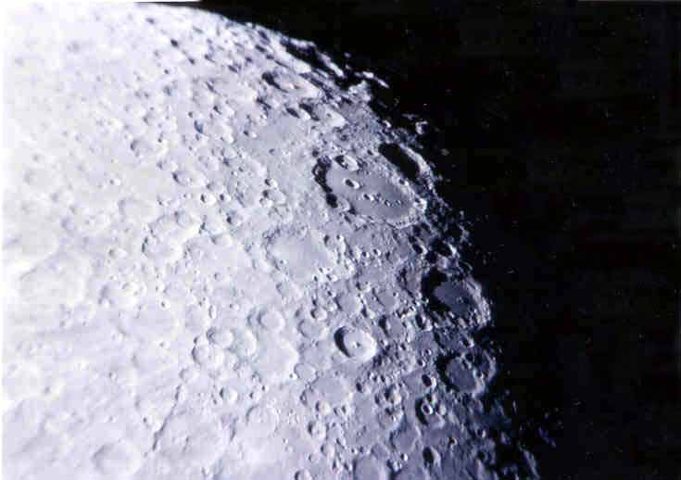
Moon craters as seen through the telescope.
Photo by
Jim Fullerton

Slide 3
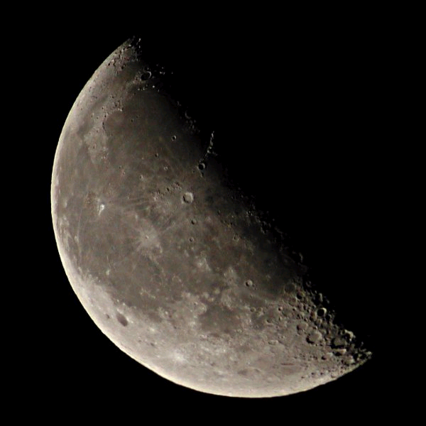
Even though the Moon is the most recognized object
in our night sky.
It is actually one of the smaller objects in our solar system.

Slide 4
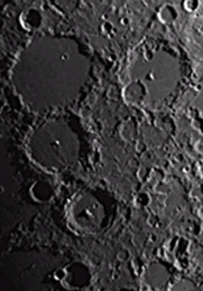
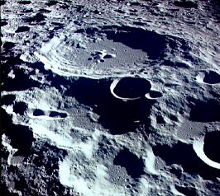
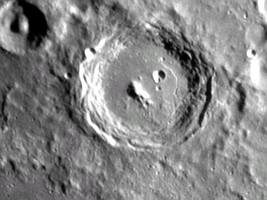
Craters are formed on the Moon when pieces of rock hit its surface.

Slide 5
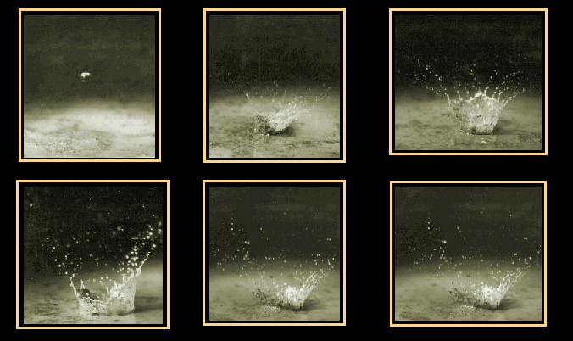
A drop of water falling onto mud shows how the crater ejecta forms.

Slide 6
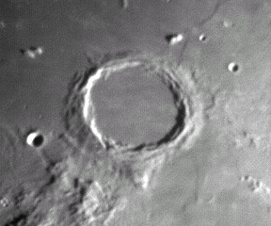
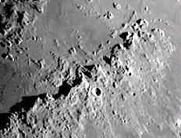
The size of a typical crater on the Moon is about 50 miles across.
Archimedes Crater
The smallest crater that can be seen with our telescope is a few miles across.
The astronauts saw craters a few inches across in diameter.

Slide 7
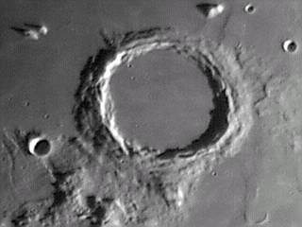
If you were to stand in the middle of the larger craters on the moon, you would not be able to see the rim.
It would be below the horizon!

Slide 8
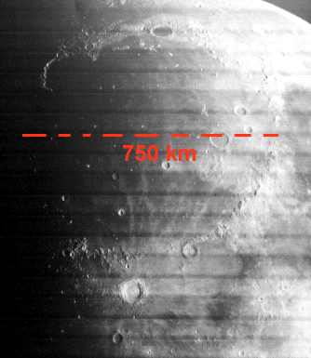
The largest impact crater visible from Earth is the Mare Imbrium basin. It is 720 miles across.
720 miles

Slide 9
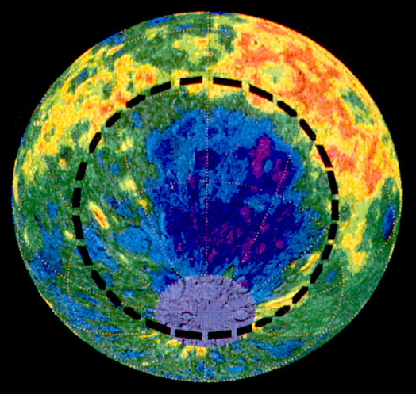
The largest impact crater of all on the Moon is located on the far side of the Moon.
The South Pole-Aitken basin is over 1500 miles across. The bottom of the basin appears blue on this height map.

Slide 10
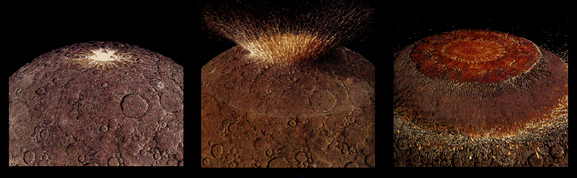
Four billion years ago the impact from a large asteroid formed a huge multi-ringed basin which then thinned and fractured the lunar crust.

Slide 11
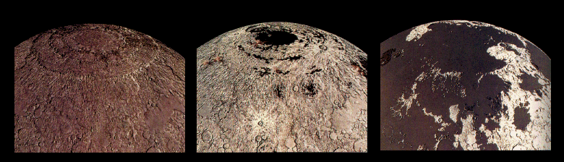
Fluid lavas from beneath the moon’s crust flowed out and flooded the low regions of the lunar surface – covering up many craters.

Slide 12
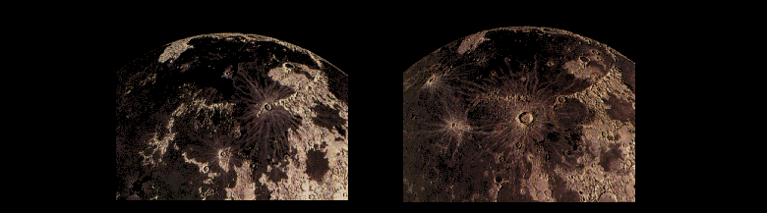
Less than a billion years after they began, the lavas ceased flowing out onto the Moons surface. However, occasionally new craters were created on top of these ancient flows.

Slide 13
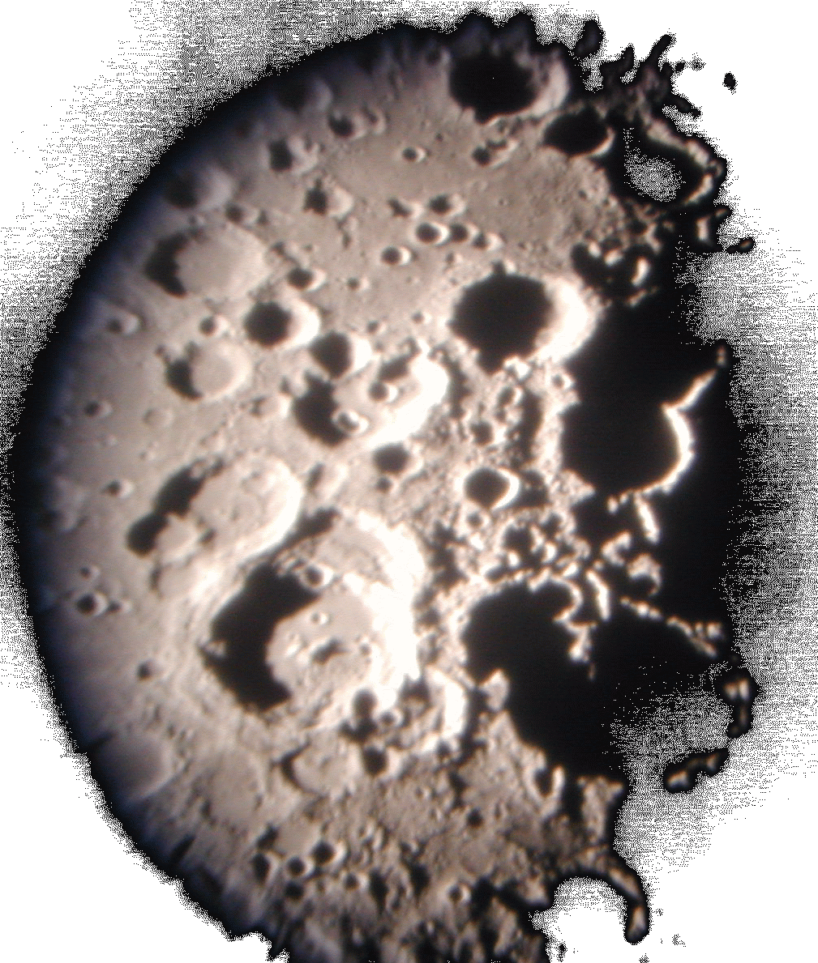
One way to determine the relative age of craters is to look for their overlap. Younger craters lie on top of older ones.
Photo by Lake Afton Public Observatory

Slide 14
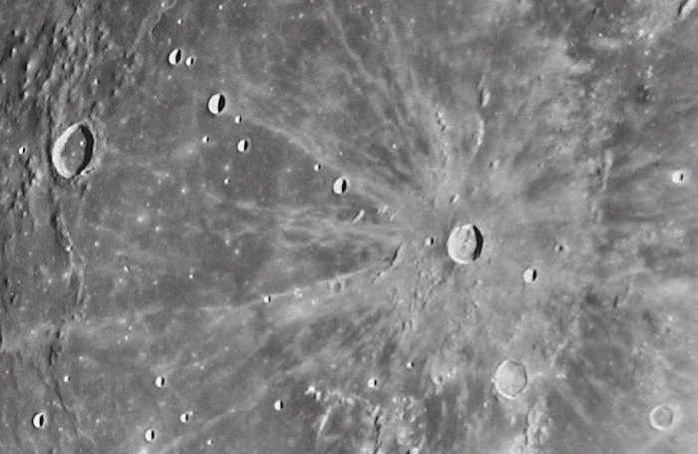
Light colored material can be seen coming from some craters.
This lighter material was ejected from the crater at impact. These are called “ray craters.” and are relatively quite young.

Slide 15
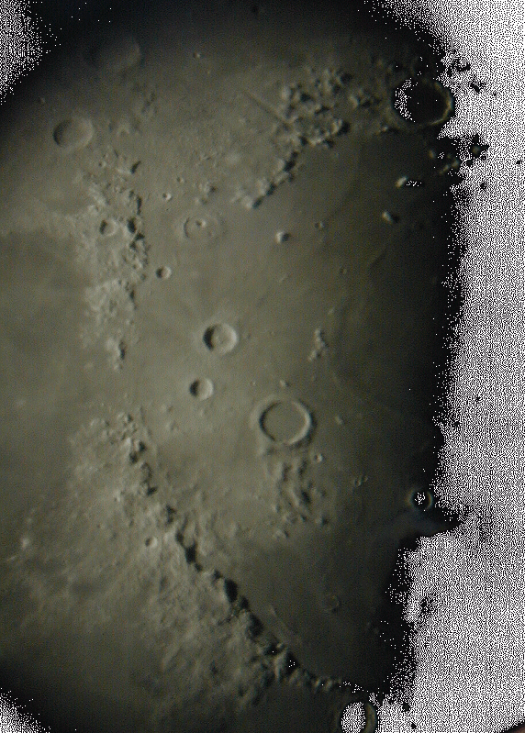
The Moon has no atmosphere or weather. There is no rain or wind to break down and erode away the craters.
Geological features can exist unchanged on the surface for billions of years.
Even after 4 billion years we can tell the order in which impact craters occured.

Slide 16
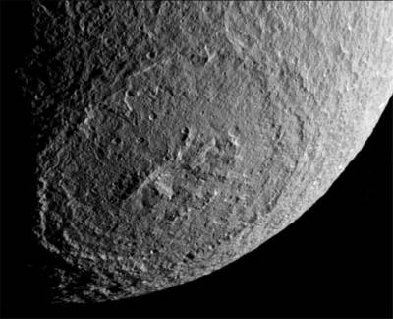
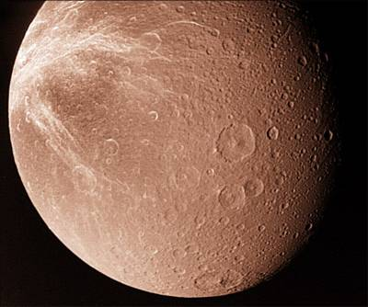
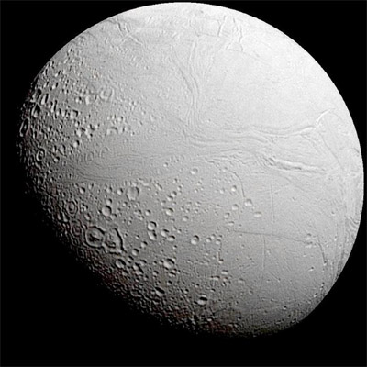
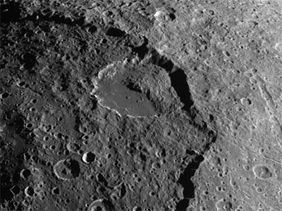
Tethys
Dione
Many of the moons of the outer planets have craters which look very much like those on our Moon.
Enceladus
Iapetus

